Slide 1
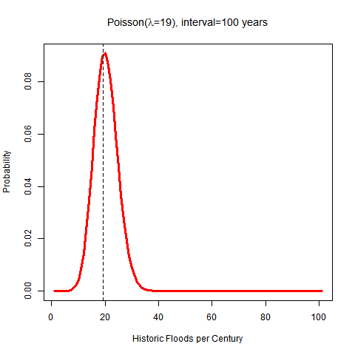
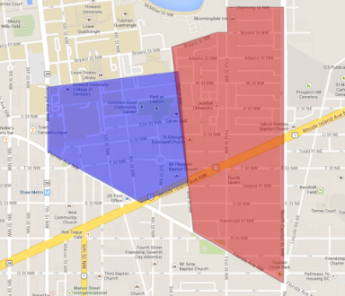
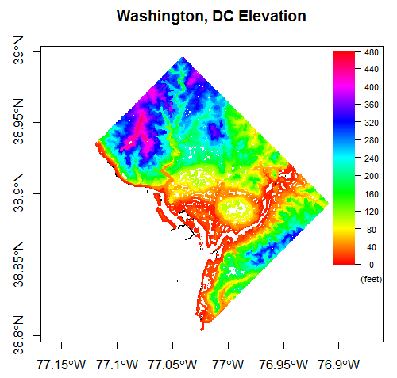
Identifying Factors that Contribute the Most to Flooding Conditions of Washington, DC’s
Bloomingdale and Ledroit Park Neighborhoods
A General Linear Modeling Approach
*Timothy Chen Allen, **Kevin Bembridge , and **Valbona Bejleri
Background
Residents and businesses of Washington, DC’s Bloomingdale and LeDroit Park neighborhoods have historically experienced severe flooding during large storms. In August 2012 the District appointed a Flood Prevention Task Force of experts and residents and has undertaken construction projects to alleviate some flooding problems in principal roadways, but longer term solutions are currently not scheduled to begin until 2022. A deeper understanding of factors that contribute to flooding conditions in the area is necessary to ensure that the District invests its resources most effectively to address this problem.
Data Sources
FEMA OpenData
Historic-level Floods
(16 in 82 years)
Community Descriptions
Flood Protection Measures
OpenData DC
Elevation
Floodplains
Water Systems
Demographics
NOAA
National Airport weather
Potomac/Anacostia River
Discharge
Height
Year | Description
1924 | 5 Deaths, $4 Million in Damage.
1924 | Greatest Damage since flood of 1889.
1933 | Chesapeake-Potomac Hurricane of 1933.
1936 | Greatest flood since 1889 .1 Exceeded flood of May 1924.
1937 | Third Largest flood after 1936 and 1889. Comparable to May 1924.
1942 | Potomac River Stage at Washington 0.3 ft higher than in 1936.
1955 | Hurricanes Connie and Diane.
1972 | Hurricane Agnes.
1979 | Hurricane David $374,000 in damage.
1985 | Hurricane Juan combined with stationary front. $9 million damage along C&O canal and $113 million along Potomac.
1989 | Three people killed, hundreds of homes and businesses destroyed.
1996 | Fifth highest flood on official record.
1996 | Hurricane Fran, flooding similar to Hurricane Juan.
2001 | Rock Creek discharge at Sherrill Drive gage about 1.5 times the 100-yr discharge.
2003 | Hurricane Isabel. Caused a system malfunction in the 14th Street pumping station. The Incident closed 395 in both directions for 48-Hours. $125 million in property damages.
2006 | Localized flooding throughout region damaged major Federal buildings. $10million in damages.
Year | Temp | Dew | Press | Prec
1/1/1973 | 60.5 | 47.7 | 1017.4 | 0
1/2/1973 | 45.9 | 21 | 1023.4 | 0
1/3/1973 | 36 | 21.3 | 1032.6 | 99.99
1/4/1973 | 39.3 | 34.6 | 1017.6 | 0.43
1/5/1973 | 44.9 | 31.5 | 1016.2 | 0.24
1/6/1973 | 35.5 | 16.7 | 1020.1 | 0
1/7/1973 | 24 | 4.7 | 1029.9 | 1.06
1/8/1973 | 22.3 | 0.9 | 1030.5 | 99.99
1/9/1973 | 23.5 | 3.2 | 1026.1 | 0
1/10/1973 | 27.1 | 7.9 | 1025.4 | 0
1/11/1973 | 32.9 | 8 | 1018.2 | 1.57
Preliminary results
Exploring data using a probability plotting technique, it was concluded the occurrences fit a Poisson distribution
Based on the “resistant line” technique, which is a method that considers fitting medians instead of the means , we
estimated about 16 flooding events occurred in 82 years within DC boundaries.
Further Work
Identify most influential factors that contribute to flooding in Washington, DC
Explain relationships between these factors
Assess the model
Estimate the uncertainty associated with model’s parameter estimates
Allow predictions
Methodology
General Linear Modeling (GLM)
Will model the chances of flood
Dichotomous response variable (flood/no flood)
Logistic regression procedure for model building
References: DCWASA (2006). Sewer investigation: Bloomingdale Neighborhood; FEMA (2010). Flood Insurance Study: District of Columbia; NCPC (2008). Stormwater in Washington, DC; Ndumbe, J. (2006). “An Analytical Study on the Anacostia and Potomac Rivers”, UDC/DCWRRI; Hoaglin, David C. (1980), “A Poissonness Plot”, The American Statistician,Vol. 34, No3, pp 146-149; Velleman, Paul F. and Hoaglin, David C. (1980), Applications , Basics, and Computing of Exploratory Data Analysis, North Scituate , Mass.: Duxbury Press: 122-135; Espinueva, S. et al (2013). Guidelines on Urban Flood Risk Management (UFRM), Proceedings of 45th ESCAP/WMO Typhoon Committee; Van Gelder, P. (1996). A new statistical model for extreme water levels along the Dutch coast. Stochastic hydraulics 96: 243-249; Nayak, P. et al. (2005). Short‐term flood forecasting with a neurofuzzy model. Water Resources Research, 41(4).
* Federal Emergency Management Agency; ** University of the District of Columbia; This research is made possible by a grant from the DC Water Resources Research Institute

